Slide 1
Gitlab Fundamentals

Slide 2
What is Git ?
●
Git: a distributed version control system (DVCS)
– A set of software tools used to:
Register and retrieve different versions of a project. Manage collaborative work.
●
Initially designed by Linus Torvalds to ease the development of the linux kernel,
free and open source.
Supported on most platforms.

Slide 3
What is Gitlab ?
●
Gitlab: a project management web application
– used to manage:
the life cycle of git projects.
the users of projects (roles, groups, etc.). the communication between users.
●
●
Developed by a private company
“community edition” is free of use.
Deployed on a server at LIRMM: gite.lirmm.fr.

Slide 4
Why Git and Gitlab ?
●
Postulate: you need a robust system to manage life cycle of your software.
Manage versions of your sources.
Add / Remove developers, change their roles within your project, etc.
Manage Bugs and other issues.
Manage online documentation.
Manage visibility of your projects.
Etc.

Slide 5
Why Git and Gitlab ?
●
Git: currently the most widely used version control system
Very popular in the open source community.
Very popular in start-ups and software companies.
●
Gitlab: like Github but private
~ same functionalities as the very popular GitHub online service.
Private instances of gitlab can be deployed in restricted access environments.
Lots of public institutions and private companies use it.
–
Very mature, stable and fast improving solution

Slide 6
What can they be used for ?
●
Software development
– Made for controlling version of source code.
Writing documents
●
–
–
–
Papers (latex sources).
Web pages (HTML, markdown, etc.). Any kind of text document (ascii format).
●
Archive projects binaries (less common use)
Released executable and libraries CAD files, etc.
–
–
!
only for saving snapshots !
6

Slide 7
Objectives of this training day
●
Learning:
root concepts of git
projects version control
collaborative work
project management using Gitlab
good practices
●
Using:
basic commands of git (work station side)
Main functionalities of Gitlab (server side)

Slide 8
Plan
●
Installation
A brief history of version control systems GIT concepts
GITLAB Server Step by step tutorial
●
●
●
●

Slide 9
Installation
●
Installing git on a workstation
– Linux (Ubuntu/Debian):
●
Base: sudo apt­get install git­core
GUI: sudo apt­get install gitk
Subversion interoperability : sudo apt­get install git­ svn
●
●
– MAC
●
Base + subversion: sudo port install git­core +svn

Slide 10
Installation
●
Configuring git on a workstation
– Configuring information about the user
●
git config ­­global user.name "Robin Passama"
git config ­­global user.email "passama@lirmm.fr"
●
Email will be used by Gitlab to identify the commits
–
Configuring git behavior
git config git config git config
­­global color.diff auto
­­global color.status auto
­­global color.branch auto
●
●
●

Slide 11
Installation
●
Configuring SSH on a workstation
●
cd ~/.ssh
●
ssh­keygen ­b 2048 ­t rsa
Enter a name for the key (e.g. name of key = name of target server)
Enter a pass phrase
Result: private and public keys generated
chmod 600 ~/.ssh/<your_private_key>
●
–
Should be unnecessary on recent systems
ssh­agent
ssh­add ~/.ssh/<your_private_key>
Enter pass phrase again
●

Slide 12
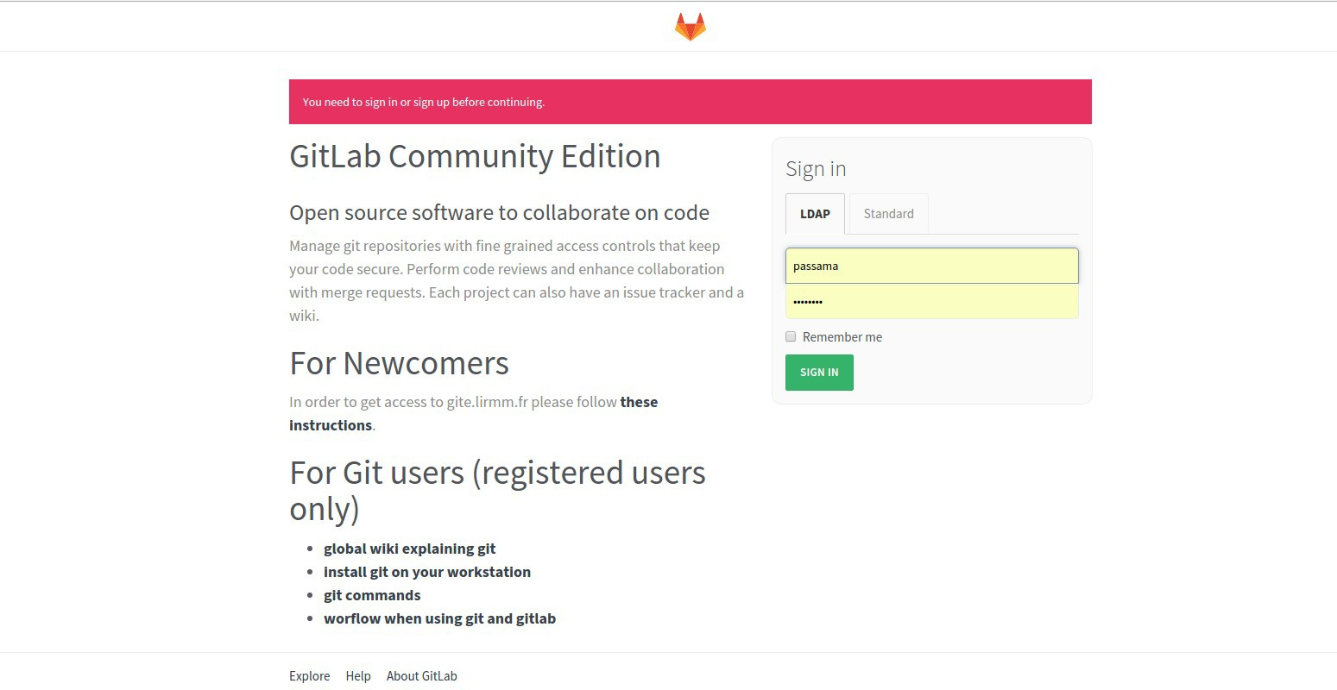


Installation
●
Sign in into gitlab
for LIRMM members: use LIRMM LDAP
for external people: ask for a login/passwd, use “standard”
Sign in
Read this first
Useful docs

Slide 13
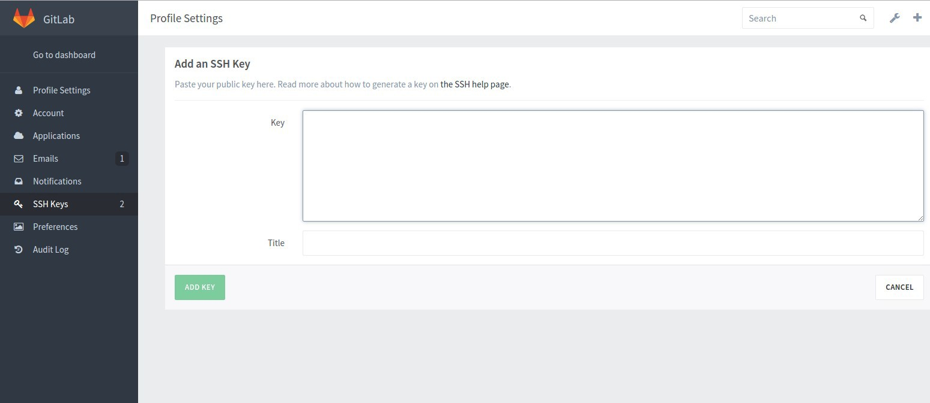


Installation
●
Add a public ssh key on server
– Go into your profile settings...
Copy/paste the content of your public ssh key
Title identifying your machine

Slide 14
Plan
●
Installation
A brief history of version control systems
GIT concepts GITLAB Server Step by step tutorial
●
●
●
●

Slide 15
History of VCS
●
During project development, you need to register some snapshots, called version or revision.
Finding a specific version (last stable, last released, etc.).
Being able to test some new ideas without “loosing” previous functional code.
Collaborative work: you need to share your changes and get changes made by others.
Manage merging of changes.
Understand what has been modified by another person.
●

Slide 16
History of VCS
●
The forerunner of VCS: CPOLD
Just a development “methodology”, no specific tool.
A folder = a project repository.
A file/subfolder name = a file/folder of the project.
A file/folder extension = a version of the file/folder.
The unique command to know: cp
●
cp file1 file1.old
cp ­R folder folder.1.4 //suppose 1.3 exists
Require strong naming and sharing (access to file server) conventions.
●
●
Quickly become difficult to manage (large or collaborative projects). Really not optimal in term of project size on disk.

Slide 17
History of VCS
●
Centralized VCS: CVS, subversion, etc.
– Set of tools based on client/server approach.
●
Use kind of diff and patch commands to automate the management of difference between files.
A specific file server manages access to and operation on files/folders.
●
A repository = a specific folder on the server.
Any modification of the repository's content is registered.
●
Files and folders modifications are registered as kind of patches, patch are ordered.
Modifications of many files/sub-folders can be registered as a unique revision, called commit.
●
– On a user workstation, only a working copy of the repository.

Slide 18
History of VCS
Branch 1
Centralized VCS: work-flow
Commit 3
Branch 2
1) Get modifications from repository:
update
Commit 2
Commit 2 bis
Central repository
!
Merge conflicts
Commit 1
Server side
3) Publish changes to repository:
commit
Client side
Working folder
Working folder
Working folder
2) Perform local changes: operations on files and folders
18

Slide 19
History of VCS
●
Centralized VCS: known limitations
– Committing
●
Impossible to work locally on a isolated set of commits, each commit requires to synchronize with the server.
Need to resolve merge conflicts BEFORE committing (painful in collaborative work).
Network access required to create commits !
●
●
– Robustness
●
Loosing a repository (corruption of data, server HD crash, etc.) is loosing the history of commits.
requires additional backup procedures for the server, not managed by the VCS.
●

Slide 20
History of VCS
●
Centralized VCS: known limitations
– Centralization
●
Network latency on many operations.
Access rights are fixed, not easy to organize into sub- groups with specific rights (may be critic for large projects).
●
– Branching model (SVN)
Merge of branches is a complex operation. Drastically increases size of the repository.
●
●

Slide 21
History of VCS
●
Distributed VCS: git, Bazaar, mercurial, etc.
Like centralized VCS but ...
using a peer-to-peer approach for synchronization operations.
A repository = a specific folder either on a server or on a workstation.
On a user workstation, a working directory connected to a local copy of the repository.

Slide 22
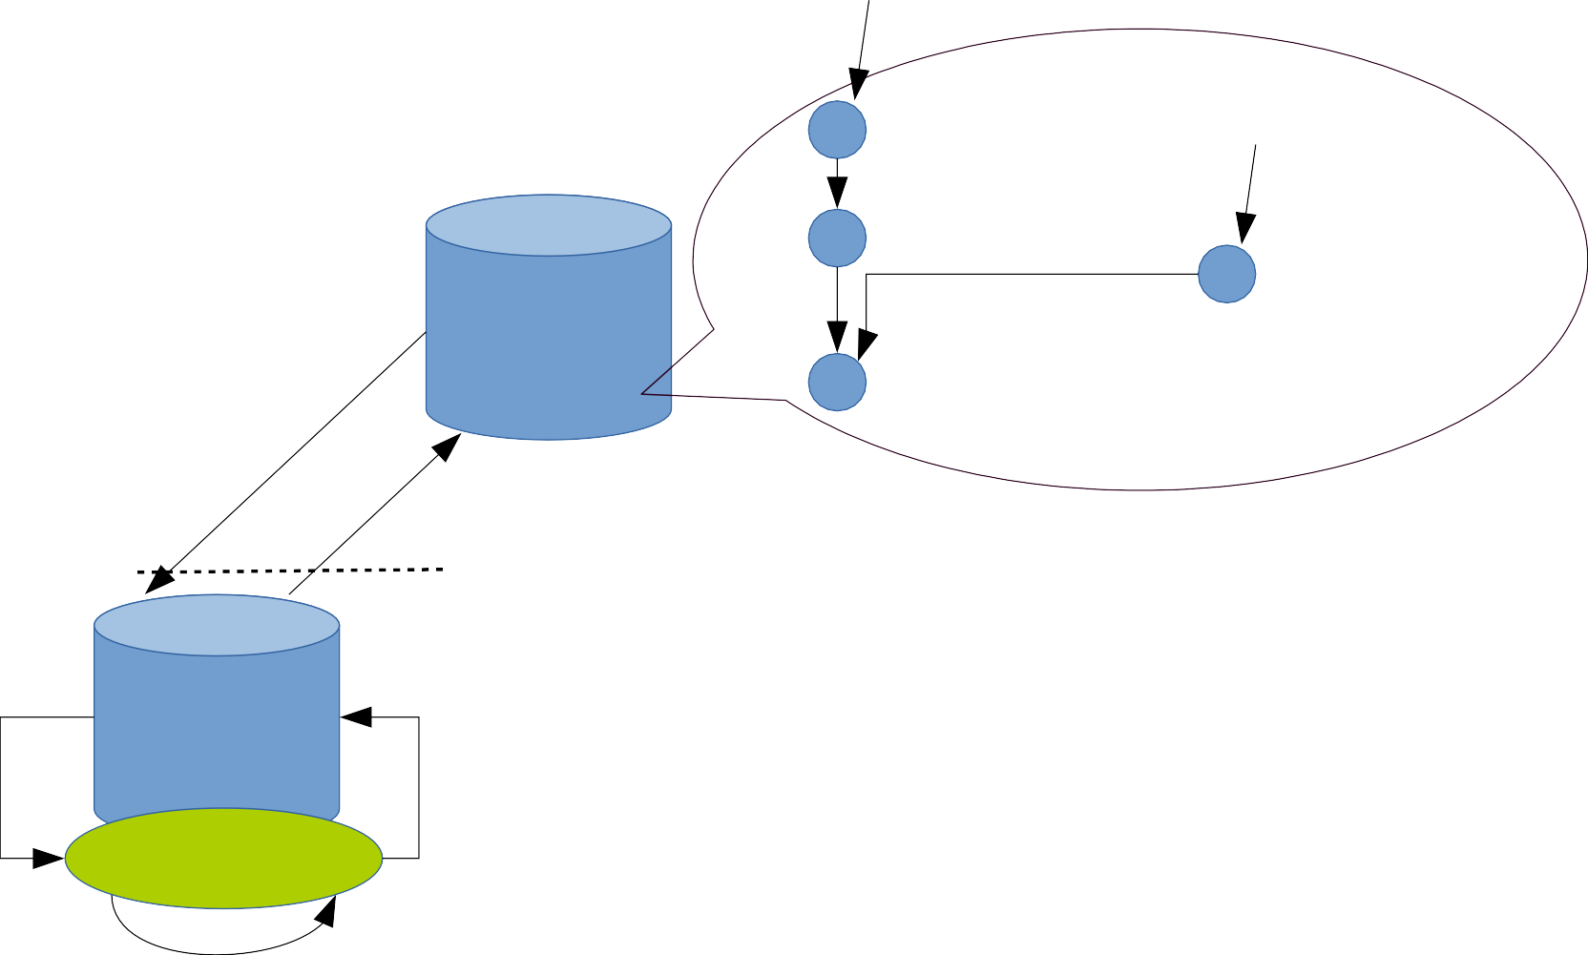
History of VCS
Branch 1
●
Distributed VCS: work-flow
Commit 3
Branch 2
Commit 2
Commit 2 bis
repository
1) Update local repository: fetch
Commit 1
5) publish changes:
push
Server side
Client side
2) Update local working folder: merge
! Merge conflicts
repository
repository
4) update local repository:
commit
Working folder
Working folder
3) Perform local changes: operations on files and folders
22

Slide 23
History of VCS
Branch 1
●
Distributed VCS: work-flow
Commit 3
Branch 2
Commit 2
Commit 2 bis
repository
repository
Commit 1
fetch
Server side
push
Branch 1
Client side
Branch 2
Commit 4
Commit 3
repository
repository
Commit 2
Working folder
Working folder
Commit 2 bis
Commit 1

Slide 24
History of VCS
●
Distributed VCS: Advantages VS Centralized VCS
– Robustness
●
Any workstation repository is a full copy of the server repository.
– Distributed
Very fast, no network latency on many operation. Local commits
Each local repository can define its own access rights.
●
●
●
– Branching model (Git)
nearly no additional cost in disk space. Merging branches is a basic operation.
●
●
– Team work-flow organization
●
Any model model is possible (even “centralized”)

Slide 25
History of VCS
●
Distributed VCS: limitations VS Centralized VCS
More commands to know and understand.
Simpler to organize around a centralized well known server rather than a collection of distributed repositories.
●
Require to define a clear team work-flow when using DVCS.
– Enforcing a policy for access control is impossible with DVCS
●
Every repository has a full copy of whole history of commits (from last
fetch).
Every repository can define its own access rights to others.
●
DVCS are intensively used in open source world, but less used in industry.

Slide 26
Plan
●
Installation
A brief history of version control systems
GIT concepts GITLAB Server Step by step tutorial
●
●
●
●

Slide 27






GIT Concepts
●
Base element: the repository
A folder with specific information related to versions
Creating a repository from a folder: git init
project_name.git
Only version related information
objects branches
repository
On a server
git init ­­bare
...
On a workstation
git init
project_name
.git
objects
...
src
- version related information
repository
- files and folders related to the current revision
Working folder
...
27

Slide 28
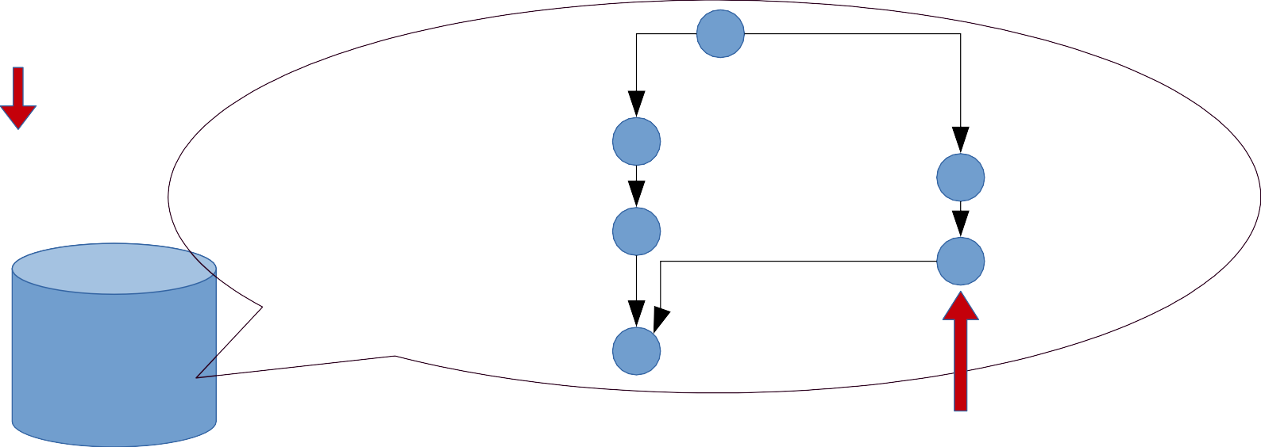
GIT Concepts
●
Atomic element in repository: the commit
A kind of patch operation (a set of modifications on files and folders content)
Uniquely identified by a SHA-1 hash code
Ordered as an acyclic oriented graph
a SHA-1 identifier
cc0df4dace69395b3d6abd096bea496005e3e397
repository
a commit

Slide 29

GIT Concepts
●
Atomic element in repository: the commit
Graph is updated when committing
The new commit contains the modifications performed from last commit
Modifications from last commit
git commit

Slide 30




GIT Concepts
●
Managing graph of commits with branches
A branch is a pointer on (i.e. a reference to) a commit.
This pointer is updated when committing: it points to the new commit.
The default branch is called master.
As many branches as you want.
– git also tracks the current branch.
master
master
Only master branch is updated
dev
dev
git commit

Slide 31



GIT Concepts
●
Memorizing interesting states with tags
A tag is a pointer on (i.e. a reference to) a commit.
Once created this pointer is never updated.
master
master
master
v1.2.3
v1.2.3
git tag ­a v1.2.3
git commit

Slide 32


GIT Concepts
●
Memorizing current state and navigating in the graph
– A specific pointer is called HEAD
●
Represents the current commit.
Used to build current state of the working folder.
New commits will be created on top of the commit pointed by HEAD.
●
●
HEAD is “detached”
master
master
HEAD
v1.2.3
HEAD v1.2.3
git checkout v1.2.3

Slide 33

GIT Concepts
●
Creating branches
Many branches can live in the same repository
Creating a branch = creating a new pointer on HEAD
master
HEAD
master
dev HEAD
master
dev HEAD
git branch dev
git checkout dev
git checkout ­b dev

Slide 34



GIT Concepts
●
Merging branches
master dev master
dev
dev
HEAD
master
HEAD
HEAD
git commit
git checkout master
master
HEAD
master
dev
git commit
dev
HEAD
git merge dev
May include conflicts resolution
May produce
conflicts
34

Slide 35
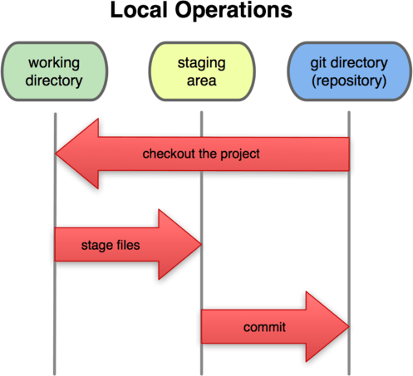
GIT Concepts
●
Local work-flow overview
Goal: “synchronize” the content of the working folder with the local repository
Originality of git: 2 phases
Related git commands
Meaning
Updating state of the working folder
git checkout
Registering modifications made in the working folder
Updating state of the repository
git add, git rm, git mv
git commit

Slide 36


GIT Concepts
●
Updating state of the working folder
Any time when checkout (or merge) is performed
~ applying the sequence of patches starting from first commit to the current commit (HEAD)
master
main.cpp in working folder
in main.cpp int main(){
+ cout<<”hello”<<endl;
int main(){ cout<<”hello”<<endl;
}
}
in main.cpp
+ int main(){
+}
git checkout master
patch operations
HEAD
add empty file
main.cpp

Slide 37


GIT Concepts
●
Staging: registering modifications of the working folder
– Selecting modifications to be part of the next commit
●
Files content modifications can be selected or not (git add ­p)
Entire file modification can be selected or new files tracked (git add filename) Removed files must be untracked (using git rm filename)
Registering all modifications (using git add ­­all)
●
●
●
– Undo staging (deselecting): git reset
main.cpp in repository
Modification registered in
staging area
in main.cpp
int main(){ cout<<”hello”<<endl;
}
main.cpp in working folder
git add main.cpp
cout<<”hello”<<endl;
+ return 0;
}
int main(){ cout<<”hello”<<endl; return 0;
}
diff operation
37

Slide 38
GIT Concepts
●
Committing to the local repository
creating a new commit from all modifications registered in the staging area.
Adding a message explaining what has been modified.
Modifications registered in
staging area
add other.cpp
in main.cpp co_{i}u_{n}t<_{m}<_{a}”_{i}h_{n}e.l_{c}l_{p}o_{p}”<<endl;
+coruett<u<r”nhe0l;lo”<<endl;
}⁺co^{r}u^{e}t^{t}<^{u}<^{r}”^{n}he⁰l;lo”<<endl;
}+ return 0;
}
Current state of the
repository
master
master
HEAD
HEAD
git commit ­m “return 0”

Slide 39
GIT Concepts
●
Why two steps committing with staging ?
create “little” commits from a big bunch of modifications in the working folder.
delay the committing of some modifications: validated part of the code are committed while other are not.
isolate non committed code (e.g. debug traces).
Once interesting modifications are committed, cleaning the staging area and the working folder is possible:
Using git reset ­­hard: permanent, code cannot be restored
Using git stash save: can be restored
●

Slide 40
GIT Concepts
●
Synchronization with remote repositories
Each repository knows a set of remotes.
The default remote is named origin.
Basic information on a remote is its url and its name (unique in the context of local repository).
Adding a remote : git remote add backup <address>
Removing a remote : git remote rm backup <address>
on server A
on server B
origin
backup
origin
official

Slide 41


GIT Concepts
●
Synchronizing local branches with remote branches
All branch of the remote are known in local repository but they are read only (impossible to directly commit to them). They are called remote tracking branches.
By default a local branch tracks the branch with the same name in its remotes (e.g. local master branch tracks origin master branch).
master
origin/master
represents
master
HEAD
remote tracking branch
HEAD
origin
Local repository
remote repository

Slide 42




GIT Concepts
●
Updating local repository from a remote
– Achieved with the fetch command.
●
graph of commits is updated.
remote tracking branches are updated.
●
Then local branches can be merged with remote tracking branches
All in one command: git pull
origin/master _{master} origin/master
master origin/master
master
git fetch origin
git merge origin/master
git pull origin master

Slide 43




GIT Concepts
●
Updating a remote branch from a local branch
– Achieved with the push command (atomic operation).
●
check if local repository's remote tracking branch is up to date.
update the graph of commits of the remote and update the tracked branch of the remote.
●
●
update the local remote tracking branch
origin/master
master
master
master
origin/master
master
git push origin master
local
remote
local
remote

Slide 44

GIT Concepts
●
Most known operation on remotes: cloning
Create a folder and initialize (git init) its repository.
Create a remote called origin (git remote add origin <address>)
Create a local master branch (git checkout ­b master)
Update local master branch (git pull origin master).
master
origin/master
master
Remote
git clone login@server:repo.git
local
Address: login@server:repo.git

Slide 45
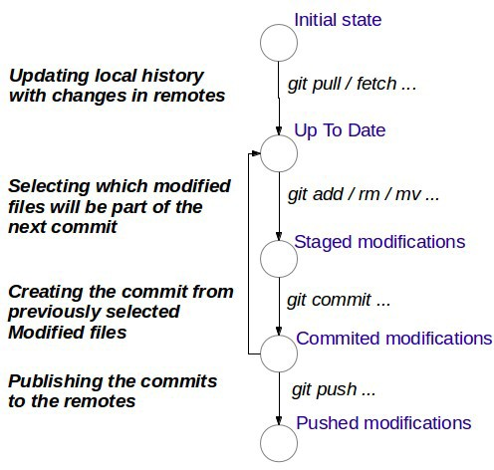
GIT Concepts
●
Typical usage

Slide 46
Plan
●
Installation
A brief history of version control systems GIT concepts
GITLAB Server
Step by step tutorial
●
●
●
●

Slide 47
GITLAB server
●
A web application to ease the management of git projects
Easy creation of server repositories.
Easy registration of users.
Easy management of access right to projects for users.
Deep integration with git: graphical tools to visualize server side commits, branches, tags, user activities, files, etc.
Additional features to manage project documentation, to get statistics about projects, to easy team communication (issues).
Implement Github-like workflow based on fork and merge requests.
LIRMM Gitlab server: gite.lirmm.fr

Slide 48
GITLAB server
Some definitions:
Project: a git repository + additional information managed by gitlab (access rights, wiki, issues, etc.).
Workspace: a place (folder on server) where to put projects (repositories).
User: a person registered in the server. Each user has a personal workspace.
Group: a community of users working on many related projects, with a specific workspace. Helps grouping related projects together.
●

Slide 49
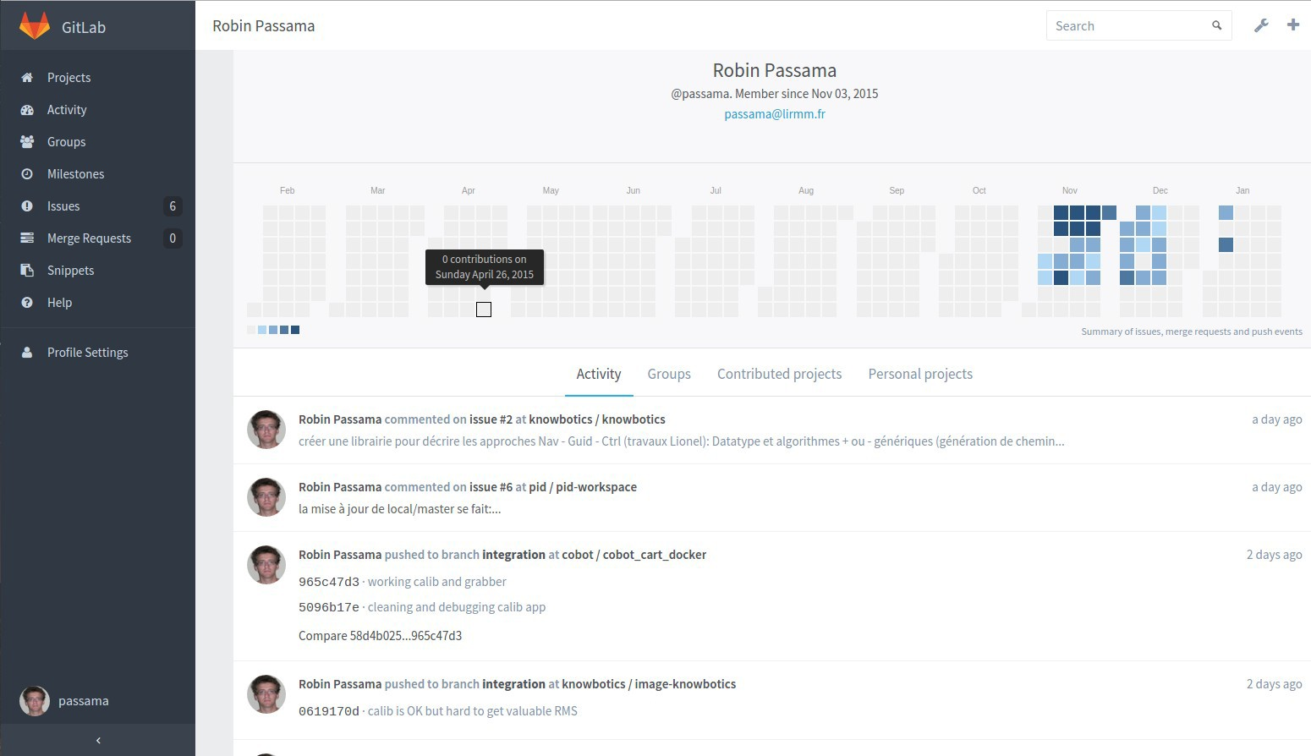






GITLAB server
●
User main page
Recent activities
Groups the user belongs to
Create new project
All projects user works on
Projects in user's personal workspace
Configuration
of user settings (SSH keys)
Direct access to this page (from anywhere)
49

Slide 50

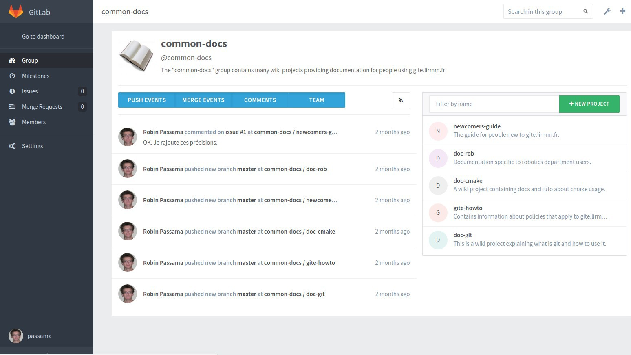





GITLAB server
●
Group main page
Workspace defined by the group
Create a new project in the group workspace
Projects in group workspace
Group members management
General configuration of the group
Recent activities in group (include other users of the group)

Slide 51

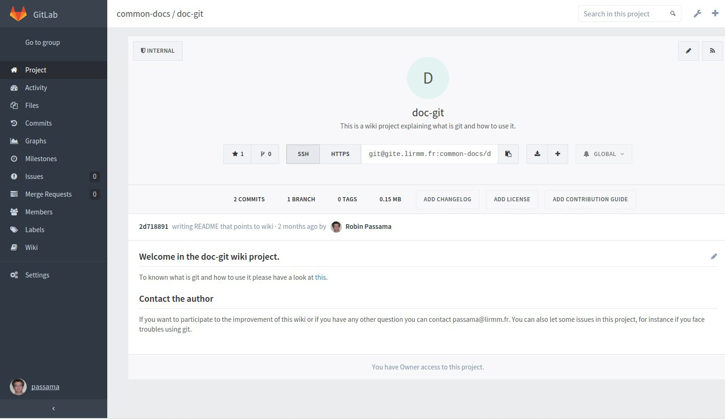






GITLAB server
●
Projects main page
Access to detailed info
Workspace containing the project
Visibility of the project (clone rights)
Address of git repository
Info on last update
Welcome web page generated from a markdown file.
My access rights

Slide 52
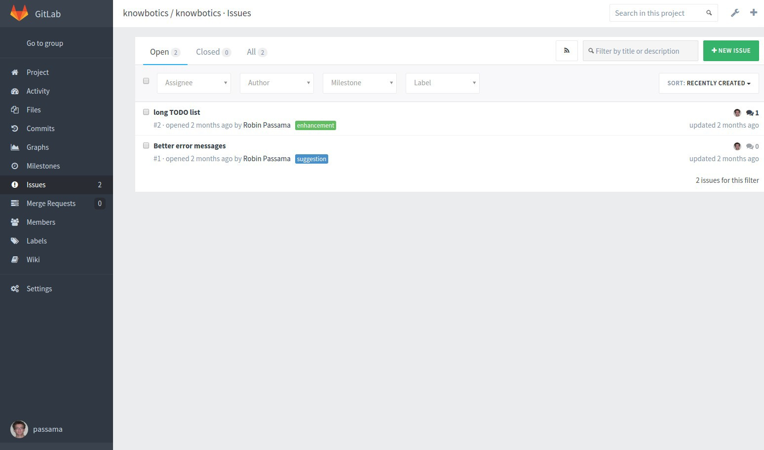
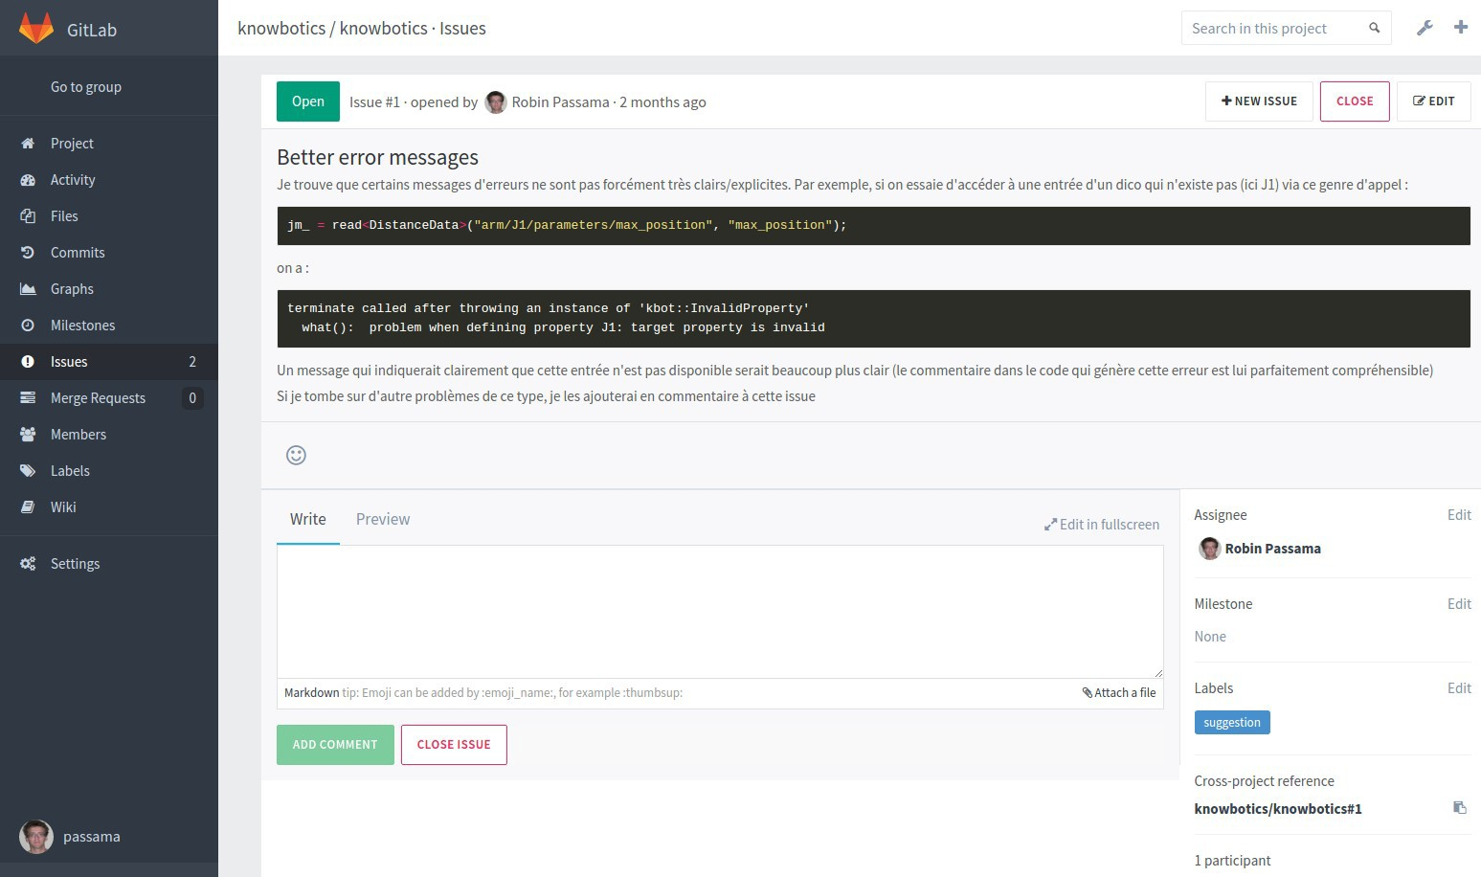






GITLAB server
●
Using issues to communicate
Declare BUGS, suggest some improvements, etc.
Open a discussion between users
Possibility to label issues to clearly categorize them (bug, suggestion, improvement, documentation, etc.)
List of open/closed issues Create new issue Content of the issue
Assignee
Labels
Discussion

Slide 53
GITLAB server
●
Github like work-flow
Based on Fork and merge request.
Fork = cloning a repository directly in gitlab (server side repository)
●
Maintain relationship between original and clone repository
– Merge request = proposing to merge a branch of the clone repository with a branch of the original repository.
Only developers of the original repository can do it. Possibility to review proposed changes
●
●

Slide 54
GITLAB server
●
Github like work-flow
Gitlab server Original repository
origin
git push origin branch git pull origin branch
Working folder
“Official” developers

Slide 55
GITLAB server
●
Github like work-flow: forking
– Clone repository is in another workspace
Gitlab server
Original repository
fork
clone repository
origin
forked
origin
Working folder
“Official” developers

Slide 56
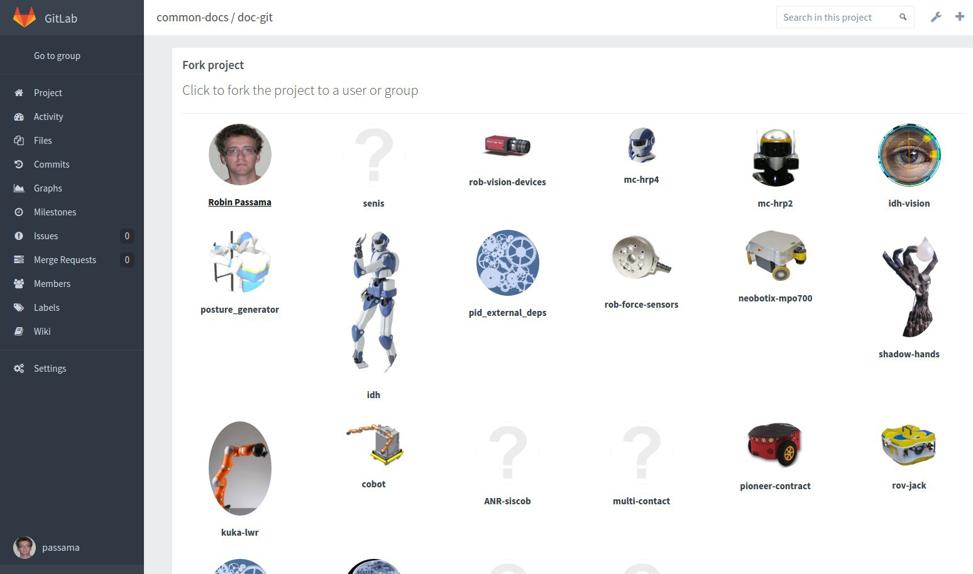

GITLAB server
●
Github like work-flow: forking
– Clone repository is in another workspace
Select in which workspace (personal or group) the project will be cloned.
56

Slide 57
GITLAB server
●
Github like work-flow : cloning
– Isolated work for external developers
Gitlab server
Original repository
clone repository
forked
origin
origin
git push origin branch git pull origin branch
Working folder
Working folder
“Official” developers
“external” developers

Slide 58
GITLAB server
●
Github like work-flow: updating external repositories
Gitlab server
Original repository
clone repository
forked
origin
official
origin
git pull official branch
Working folder
Working folder
“Official” developers
“external” developers

Slide 59
GITLAB server
●
Github like work-flow: merge request
Developers of clone decide to propose a merging of a branch.
Developers of original decide if merge is performed.
Gitlab server
Original repository
clone repository
Merge request
forked
Accept merge request: git pull forked branch
59

Slide 60
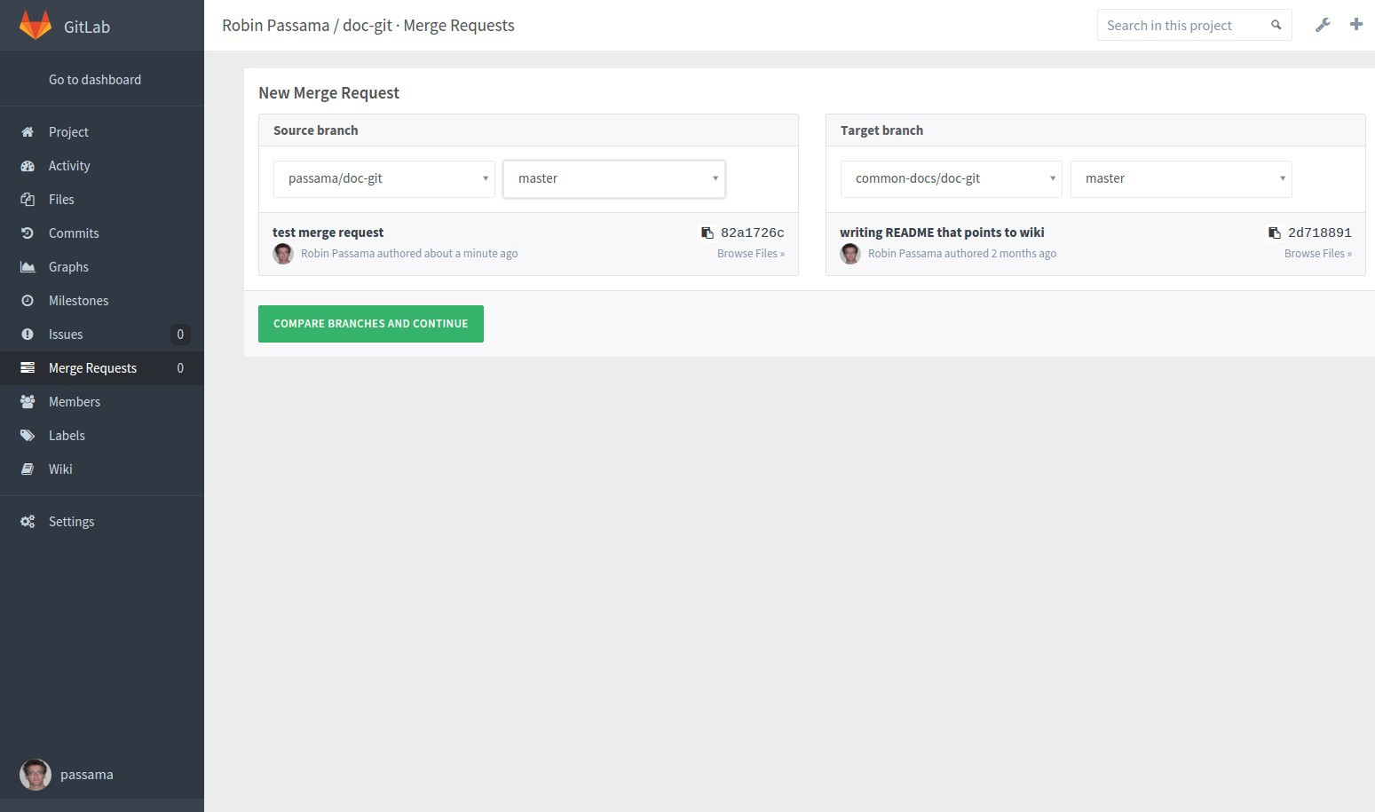
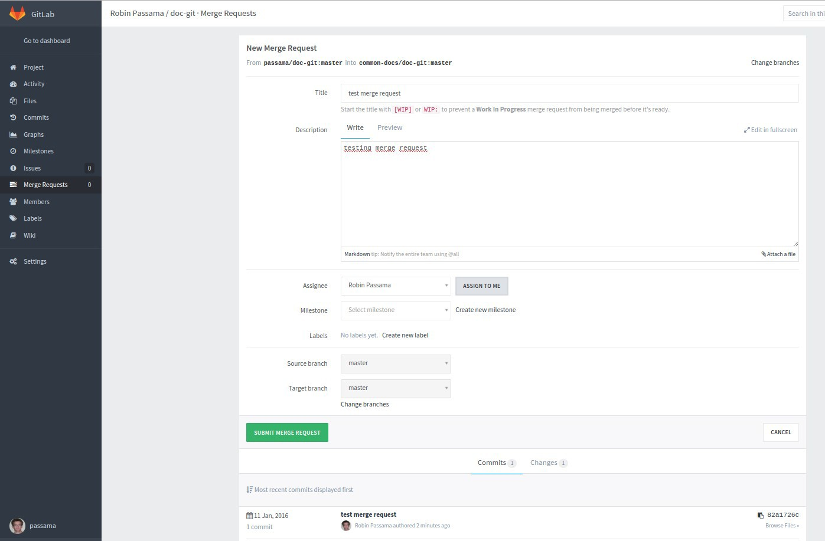





GITLAB server
●
Github like work-flow: proposing a merge
Selecting source (from clone)
and target (from original) branches
Explaining the merge request
Developer from original repository in charge of managing the merge request
Commits proposed by the merge request
60

Slide 61
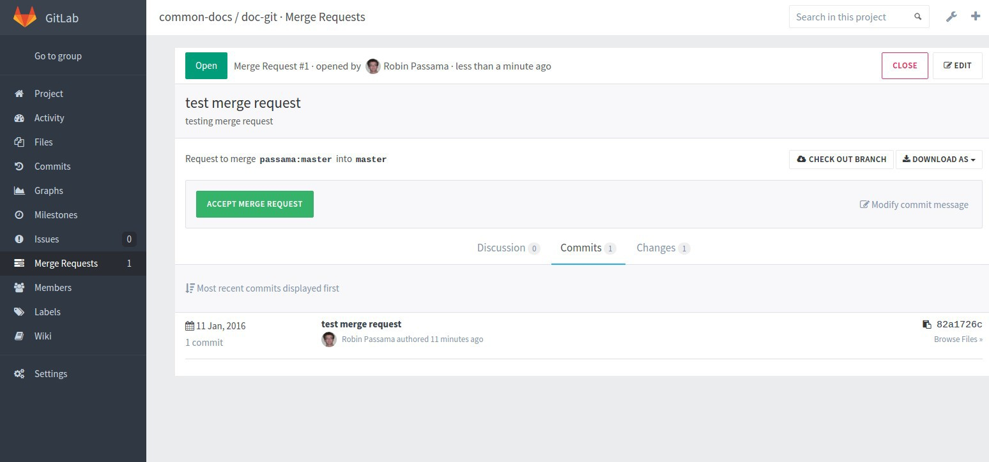




GITLAB server
●
Github like work-flow: accepting a merge
Closing or accepting merge request
Start a discussion with people proposing the merge
List of changes

Slide 62
Plan
●
Installation
A brief history of version control systems GIT concepts
GITLAB Server
Step by step tutorial
A first project
Collaborative work
Useful tips and advices
●
●
●
●

Slide 63
Tutorial: first project
●
In Gitlab:
Search for git-first-example in search bar.
Go to the project and get the address of the repository.
●
In your workstation, open a terminal:
–
–
cd <somewhere>
git clone git@gite.lirmm.fr:common­docs/git­first­ example.git
cd git­first­example && ls ­la
–
●
Open README.md and look at its content

Slide 64
Tutorial: first project
●
Listing branches:
– git branch
Only master branch appear (default local branch)
git branch ­a
origin/master and origin/dev branches also appear (you can find them on Gitlab)
–
The current branch is shown by an asterisk To automate the visualization of current branch
see last section of https://gite.lirmm.fr/common- docs/doc-git/wikis/tips:
parse_git_branch() ...
●

Slide 65
Tutorial: first project
●
Working on dev branch
–
–
git checkout dev #change current branch
ls ­la //there is one more file now
Open README.md and look at its changed content Role of .gitignore file:
Exclude from version control files that match the pattern (here all file with a terminal '~').
Applies to sub-folders...
… But sub-folders may contain their own .gitignore. Git manage version of .gitignore file itself!
●
●
●

Slide 66
Tutorial: first project
●
To visualize your local repository
git log #text version gitk #graphical tool
–
–
●
To visualize server repository
Click on “commit” menu of the project (left side panel), then:
Click on “Network” tab (~= gitk), or
Click on “Commits” tab (~= git log) after selecting the branch.

Slide 67
Tutorial: first project
●
Check the status of your working folder
git status
Sur la branche dev
Votre branche est à jour avec 'origin/dev'.
...
Nothing to do for now...

Slide 68
Tutorial: first project
●
Modify the content of README.md
Add text where you want ...
Check again the status of your working folder:
git status
Sur la branche dev
Votre branche est à jour avec 'origin/dev'.
●
Modifications qui ne seront pas validées :
(utilisez "git add <fichier>..." pour mettre à jour ce qui sera validé)
(utilisez "git checkout ­­ <fichier>..." pour annuler les modifications dans la copie de travail)
modifié: README.md
aucune modification n'a été ajoutée à la validation (utilisez "git add" ou "git commit ­a")

Slide 69
Tutorial: first project
●
To see difference between last commit and your modifications
git diff
'+' indicates that a file has been added or content has been added into file.
'­' indicates that a file has been removed or content has been removed into file.

Slide 70
Tutorial: first project
●
Now you need to select modifications
– git add ­A #all modifications are staged

Slide 71
Tutorial: first project
●
You need to stage your modifications
git add ­A #all modifications are staged
Check again the status of your working folder:
git status
Sur la branche dev
Votre branche est à jour avec 'origin/dev'.
●
Modifications qui seront validées :
(utilisez "git reset HEAD <fichier>..." pour désindexer)
modifié:
README.md

Slide 72
Tutorial: first project
●
Now you need to commit your changes to your local repository
dev
origin/dev
first modif
dev origin/dev
dev version of README
dev version of README
Adding gitignore
Adding gitignore
origin/master
origin/master
master
Add a readme
master
Add a readme

Slide 73
Tutorial: first project
●
Committing your modifications
– git commit ­m “first modif” #all staged modifications are committed
●
Check again the status of your working folder:
– git status
Sur la branche dev
Votre branche est en avance sur 'origin/dev' de 1 commit.
(utilisez "git push" pour publier vos commits locaux)
rien à valider, la copie de travail est propre
Use gitk to see the new status of your repository
●

Slide 74
Tutorial: first project
●
Publishing modifications to the server repository
git push origin dev
FAILED !!!
Normal situation: you simply do not have right to push !
Remedy: Fork the server repository into your personal workspace
You are owner of this new repository, you can push to any branch.
Copy the address of the clone server repository.
●

Slide 75
Tutorial: first project
●
Change the origin of your local repository
git remote set­url origin <address of the clone repository>
Verify the change
git remote ­v
New architecture
●
●
common-docs/git-first-example Your Name/git-first-example forked
 | origin
Working folder
Gitlab server
Your workstation

Slide 76



Tutorial: first project
●
Again, publishing modifications to the server repository
– git push origin dev
Now it works !
Delta compression using up to 4 threads.
Compressing objects: 100% (3/3), done.
Writing objects: 100% (3/3), 334 bytes | 0 bytes/s, done.
Total 3 (delta 1), reused 0 (delta 0)
To git@gite.lirmm.fr:passama/git­first­example.git
Target remote
0ca3e2d..321b394 dev ­> dev
repository
Local (source) branch
remote (updated) branch

Slide 77
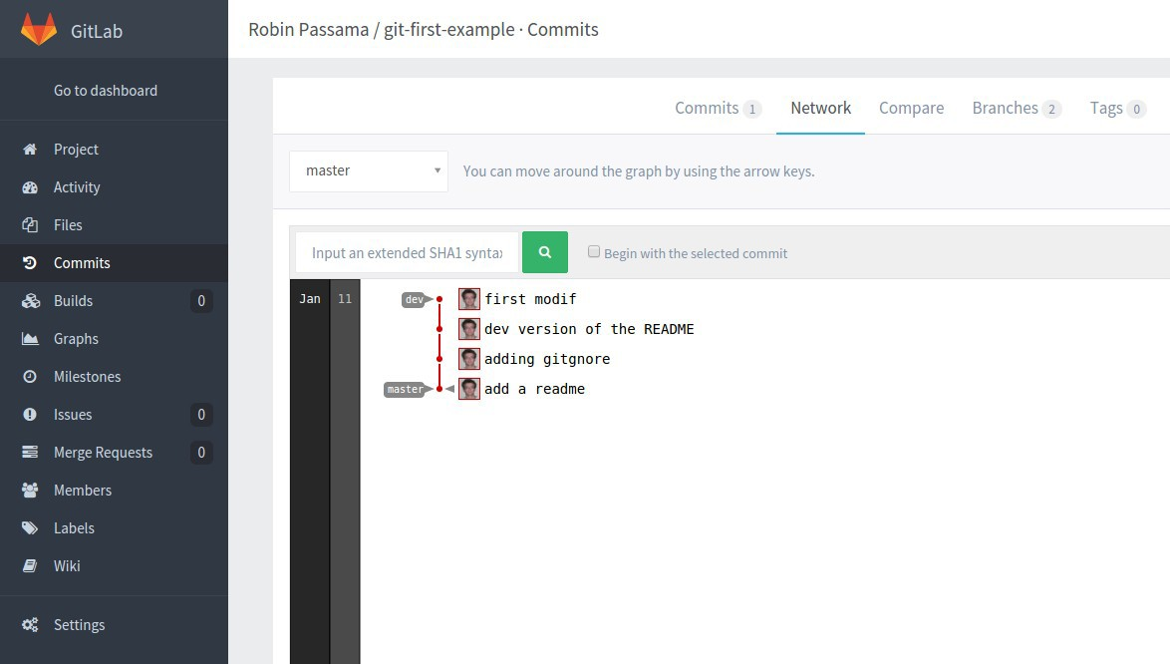
Tutorial: first project
●
Check modifications in gitlab
– Go to “commits” menu > “Network” tab
You should see something like:
●

Slide 78
Tutorial: first project
●
Now create a new branch
git checkout ­b new­feature
git branch #current branch has changed
●
Graphically
HEAD
origin/dev
Just a new pointer
new-feature HEAD
origin/dev
dev
dev
first modif
first modif
dev version of README
dev version of README
Adding gitignore
Adding gitignore
origin/master
origin/master
master
Add a readme
master
Add a readme

Slide 79
Tutorial: first project
●
Create new content
mkdir dir && nano dir/newfile
Input some text and write newfile (Ctrl+O, Enter, Ctrl + X)
nano dir/otherfile
Input some text and write otherfile (Ctrl+O, Enter, Ctrl + X)
Check the status of your working folder:
– git status
Sur la branche new­feature
Fichiers non suivis:
(utilisez "git add <fichier>..." pour inclure dans ce qui sera validé)
●
dir/
aucune modification ajoutée à la validation mais des fichiers non suivis sont présents (utilisez "git add" pour les suivre)

Slide 80
Tutorial: first project
●
Let's suppose you want to separate your modifications into 2 commits
git add dir/newfile
git status
Sur la branche new­feature Modifications qui seront validées :
(utilisez "git reset HEAD <fichier>..." pour désindexer)
nouveau fichier: dir/newfile
Fichiers non suivis:
(utilisez "git add <fichier>..." pour inclure dans ce qui sera validé)
dir/otherfile
– git commit ­m “adding newfile”

Slide 81
Tutorial: first project
●
Let's suppose you want to separate your modifications
into 2 commits
git add dir/otherfile
git commit ­m “adding otherfile”
new-feature HEAD
new-feature
HEAD
adding otherfile
adding newfile
origin/dev
dev
first modif
origin/dev
dev
dev version of README
first modif
dev version of README
Adding gitignore
origin/master
Adding gitignore
master
Add a readme
origin/master
master
Add a readme

Slide 82
Tutorial: first project
●
Creating 2 commits from two modifications
– Edit newfile and input 2 new lines one at the beginning, one at the end of the file
git add ­p
Select 'y' for first line modification Then select 'n' for last line modification
git commit ­m “adding only first line”
git add ­p
Select 'y' for last line modification
git commit ­m “adding last line”

Slide 83
Tutorial: first project
Result
new-feature
HEAD
adding last line
adding only first line
new-feature
adding otherfile
adding newfile
HEAD
adding otherfile
adding newfile
origin/dev
dev
first modif
origin/dev
dev
dev version of README
first modif
dev version of README
Adding gitignore
origin/master
Adding gitignore
master
Add a readme
origin/master
master
Add a readme
Good practice: by default use git add ­p to check modifications you will commit

Slide 84
Tutorial: first project
●
Undo a sequence of commit
Finally, we want to remove the two last commits...
git log
Copying the SHA1 identifier of the commit preceding these two commits.
git reset <SHA­1­ID>
Modifications non indexées après reset : M dir/newfile
git status
Modifications qui ne seront pas validées :
modifié: dir/newfile
Modifications contained in the removed commits are now again in working folder
WARNING: Never use git reset on a published content (only local commits not pushed)
!

Slide 85
Tutorial: first project
Result
new-feature
HEAD
adding last line
adding only first line
new-feature
adding otherfile
adding newfile
HEAD
adding otherfile
adding newfile
origin/dev
dev
first modif
origin/dev
dev
dev version of README
first modif
dev version of README
Adding gitignore
origin/master
Adding gitignore
master
Add a readme
origin/master
master
Add a readme

Slide 86
Tutorial: first project
Get rid of these modifications
How can I remove these modifications from working folder ? 2 solutions:
git reset ­­hard <SHA­1­ID> #use ­­hard in previous command
●
Definitive cleaning !
– git stash (or git stash save)
Modifications contained in working folder are put in a temporary commit object and cleaned from working folder. Then you can do either:
Reapply saved changes to working folder and delete the stash:
git stash pop
Forget all stashed changes (definitive)
git stash clear
●
●

Slide 87
Tutorial: first project
●
Undo a commit
Finally, we want to undo modification made in commit “first modif”.
git log
Copying the SHA1 identifier of the commit to undo.
– git revert <SHA­1­ID>
●
A new commit object is generated !

Slide 88
Tutorial: first project
●
Result
new-feature
HEAD
Revert "first modif"
new-feature
adding otherfile
adding newfile
adding otherfile
HEAD
adding newfile
origin/dev
dev
origin/dev
dev
first modif
first modif
dev version of README
dev version of README
Adding gitignore
Adding gitignore
origin/master
origin/master
master
Add a readme
master
Add a readme
Good practice: by default use git revert since it is not dangerous (can be done on published commits)

Slide 89
Tutorial: first project
●
Let's suppose the new feature is finished, we want to update dev branch with it.
git checkout dev #go to dev branch
git merge new­feature
Mise à jour 321b394..2a77b12
Fast­forward
Sum up of all
modifications since last commit
3 files changed, 13 insertions(+), 1 deletion(­p)reviously pointed
README.md | | | 1 | ­
dir/newfile | | | 7 | +++++++
dir/otherfile | | | 6 | ++++++
create mode 100644 dir/newfile create mode 100644 dir/otherfile
by dev
●
Then we want to delete new­feature branch (no more useful)
– git branch ­D new­feature

Slide 90
Tutorial: first project
Result
new-feature
dev HEAD
Revert "first modif"
HEAD
Revert "first modif"
adding otherfile
adding newfile
adding otherfile
adding newfile
origin/dev
dev
first modif
origin/dev
first modif
dev version of README
dev version of README
Adding gitignore
Adding gitignore
origin/master
origin/master
master
Add a readme
master
Add a readme

Slide 91
Tutorial: first project
●
Let's suppose development is finished, we do not need dev anymore.
git checkout master #go to master branch
git merge dev
●
Then we want to delete dev branch on local workstation and on server
Delete local branch
git branch ­D dev
Delete remote branch
git push origin :heads/dev
To git@gite.lirmm.fr:passama/git­first­example.git
­ [deleted] dev

Slide 92
Tutorial: first project
●
Result
dev HEAD
master
Revert "first modif"
HEAD
Revert "first modif"
adding otherfile
adding newfile
adding otherfile
adding newfile
origin/dev
first modif
first modif
dev version of README
dev version of README
Adding gitignore
Adding gitignore
origin/master
origin/master
master
Add a readme
Add a readme

Slide 93
Tutorial: first project
●
Memorizing the state of the repository
git tag ­a v1 "version1"
Then update server repository
git push origin master
git push origin v1
●
●
Any time you want to go back to this state
– git checkout v1

Slide 94

Tutorial: first project
●
Result
master
v1
origin/master
master
HEAD
Revert "first modif"
HEAD
Revert "first modif"
adding otherfile
adding newfile
adding otherfile
adding newfile
first modif
first modif
dev version of README
dev version of README
Adding gitignore
Adding gitignore
origin/master
Add a readme
Add a readme

Slide 95
Plan
●
Installation
A brief history of version control systems GIT concepts
GITLAB Server
Step by step tutorial
A first project
Collaborative work
Useful tips and advices
●
●
●
●

Slide 96
Tutorial: collaborative work
●
In Gitlab create a group for 3-5 persons
– A group is a set of related projects.
●
A group defines a workspace for projects.
– A group defines a set of developers working on these projects.
!
Group names are unique in the server

Slide 97
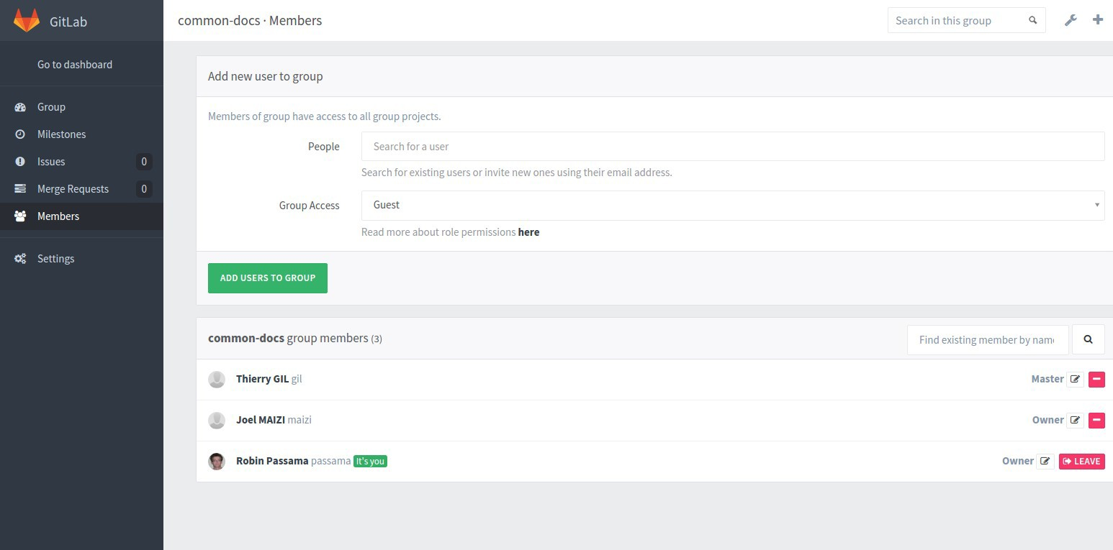




Tutorial: collaborative work
●
Now you have to add members to this group
Defining role of new group members Selecting new group members
Registered group members
Group members roles

Slide 98
Tutorial: collaborative work
Guest: cannot pull/clone repository, can only create issues. Reporter: Guest + can pull/clone repository
Developer: Reporter + can contribute (push to non protected branches, create and manage merge request, write wiki, etc.)
Master: Developer + manage team, manage branch protection, push to protected branch, can create projects in group.
Owner: Master + manage project configuration (create, rename, remove, switch visibility, etc.), manage group membership.
●
Understanding permissions attached to roles
– Available roles:
●
●
●
●
●
– A role in a group implies at least same role in all projects of this group.

Slide 99
Tutorial: collaborative work
Now create a project test­git in the group (Master or owner of the group)
All members of the project must be at least
Developer (need push rights).
In a project you can invite people not belonging to the group.
You can add greater permissions to people of the group.
●
Click on “new project” in the group page.

Slide 100
Tutorial: collaborative work
●
The Owner of test­git has to initialize the project:
Locally, open a terminal:
cd <somewhere>
– mkdir test­git
– cd test­git
then edit README.md and edit a .gitignore file (ignore temporary files)
–
– git init #transform an existing folder into a git repository
git add ­­all
git commit ­m “first commit”
git remote add origin <address of the project created in Gitlab> git push origin master
–
–
●
In Gitlab your project is initialized
Good practice: create a README.md file when creating your project (use markdown syntax) to generate simple welcome page.

Slide 101
Tutorial: collaborative work
●
For other members of the group
– Locally, open a terminal:
– cd <somewhere>
git clone <address of the project created in Gitlab>
–
●
Now you are ready for collaborative work

Slide 102
Tutorial: collaborative work
●
Owner or a Master creates a file file1.cpp, then writes some content like:
#include <iostream> int main(){
cout<<”Hello world”<<endl; return 0;
}
Then commit and publish this modification as usual:
git add file1.cpp
git commit ­m “adding file1”
git push origin master
●

Slide 103
Tutorial: collaborative work
●
Now other members have to update their local repository:
– git pull origin master
●
This pull command does:
A fetch of the repository (getting all new modifications from server repository).
A merge of the origin/master branch into local
master branch.

Slide 104
Tutorial: collaborative work
●
Pull effect
master
new commit
master
new commit
In gitlab server
first commit
In gitlab server
first commit
origin/master
origin/master
master
master
first commit
On user workstation
new commit
On user workstation
first commit

Slide 105
Tutorial: collaborative work
●
Now all users of the group except Master and Owner
modify the file file1.cpp in their local repository.
Then, commit and push the changes to master
git push origin master
FAILED
Normal situation since master branch is protected by default
Only Masters and Owners can push to protected branches by default.
Why: prevent branch deletion and forced push by developers
●
●

Slide 106
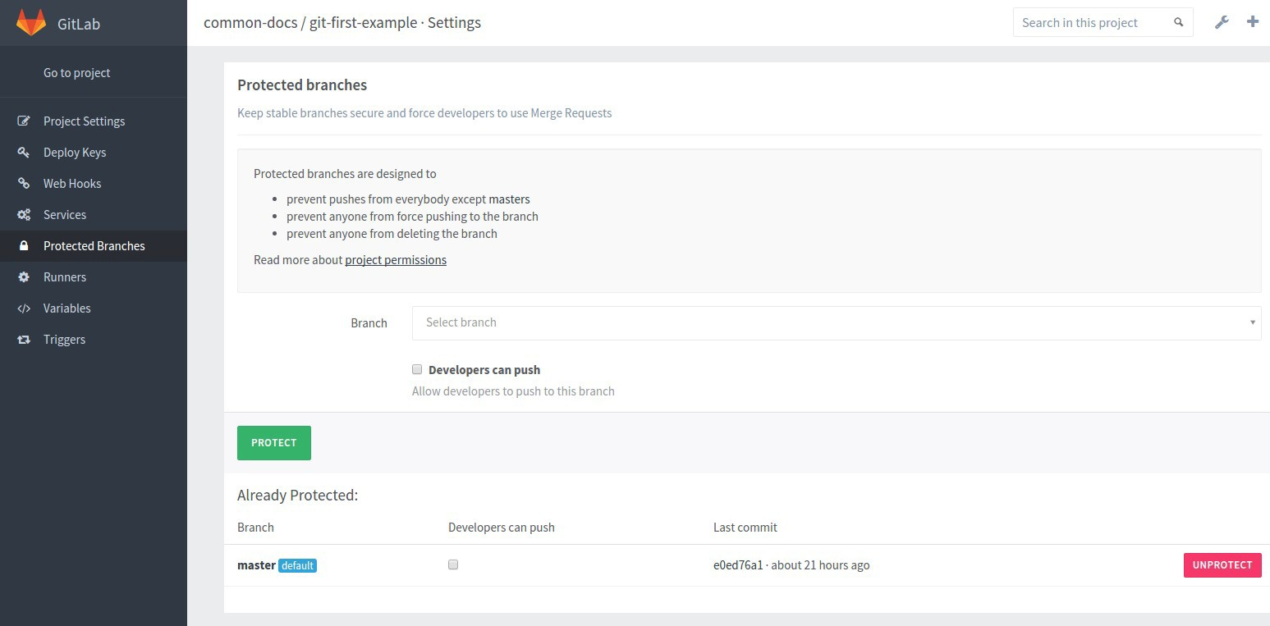


Tutorial: collaborative work
●
Manage branch protection in Gitlab
– Go to project settings > “protected branches”
Select branch to protect
Unprotect the branch
Good practice: keep master branch protected and do not allow developers to push
106

Slide 107
Tutorial: collaborative work
●
Solution: developers create another branch and propose a merge request
– Create a new branch on server
git checkout ­b <my­branch­name> git push origin <my­branch­name>
●
Propose a merge request
In Gitlab create a new merge request with
<my­branch­name> as source
master as target

Slide 108
Tutorial: collaborative work
●
Now Owner and Master can manage the merge request directly in gitlab
In “merge requests” menu of the project, check for modifications,
if OK, accept the merge request.
If conflicts, they must be resolved “by hand” (i.e. in your local repository):
git checkout master #in case of
git pull origin master #update master git pull origin:<branch name> master
– Should complain about a conflict
●
●

Slide 109
Tutorial: collaborative work
●
Resolving a conflict
– To get information about the conflict
git status
# On branch master
# You have unmerged paths.
# (fix conflicts and run "git commit") #
# Unmerged paths:
# (use "git add ..." to mark resolution) #
# both modified: file1.cpp
Files where to find conflicts

Slide 110
Tutorial: collaborative work
●
Resolving a conflict
– Look into these files you should see something like
the number of planets are
<<<<<<< HEAD
nine
=======
eight
What you current branch contains
>>>>>>> <the branch name>
What merged branch contains

Slide 111
Tutorial: collaborative work
●
Resolving a conflict
Resolution = choosing alternative (or rewriting everything) + deleting specific comments
the number of planets are eight
Then doing a specific commit:
git commit ­am “conflict on planets resolved” #add ­­all and commit in one step is possible
Then updating server master branch
git push origin master

Slide 112
Tutorial: collaborative work
●
Repository, after a merge (conflicting or not, coming from local or remote branches)
master
merge commit
commit from user1
commit from user2
new commit
first commit
●
When no conflict, merge commit is generated automatically

Slide 113
Tutorial: collaborative work
●
Most of time, Developers should resolve merge by themselves
– Create a kind of “sandbox” branch shared by all contributors. Example names: dev, integration.
git checkout ­b dev git push origin dev
●
●
– Master branch is updated (by merge) only when
dev branch state is considered as “stable”.
Good practice: make dev branch protected but allow developers to push (ensure branch will not be deleted)

Slide 114
Tutorial: collaborative work
●
All users
– Get the dev branch
●
git fetch origin #update repository
git checkout dev #local dev branch is automatically created
●
Write some code and commit it to dev branch
Update repository by pulling origin dev branch
Eventually resolve conflicts on local workstation
Once done push to origin dev branch
Etc.

Slide 115
Plan
●
Installation
A brief history of version control systems GIT concepts
GITLAB Server
Step by step tutorial
A first project
Collaborative work
Useful tips and advices
●
●
●
●

Slide 116
Tutorial: Useful tips and advices
●
Control Visibility of your project with Gitlab
– To keep your project private use “private” visibility.
Only members of the project (or group) can clone/fork it if they have adequate rights.
– To share your project with the world set it “public”.
●
Not recommended, instead use popular services like github.com, gitlab.com or SourceSup, for better visibility !
– To share with any people from LIRMM, set it “internal”.
●
●
Anyone connected can find and clone the project.
Anyone connected can fork the project to contribute via merge requests.
●

Slide 117
Tutorial: Useful tips and advices
●
Typical organization of “big” software projects
– Create a group for a big project
Owners of the group are project managers others are Developers.
●
●
– Create one Gitlab project for each “independent” element of your software,
●
Each manager of individual project is a Master (or
Owner).
Other are Developers.
●

Slide 118
Tutorial: Useful tips and advices
●
With Gitlab, use issues and code snippets to communicate on bugs, improvements, suggestions
Issues are the best way to keep traces of important things to do, improvements, etc.
Use labels on issues to clearly identify the subjects of your issues (bugs, documentation, etc.)
Use code snippet to write examples of code, to report long error messages, etc. then reference them in issues.

Slide 119
Tutorial: Useful tips and advices
●
Use git­svn to port your projects into git world
– Import the entire SVN repository into a git repository
git svn clone <address> ­s
This operation may be quite long for repositories with a lot of commits
!
Create the corresponding project in Gitlab, then
git remote rename origin svn­server
git remote add origin <gitlab project address>
Push all branches and tags to this new repository ... finished !
git push origin ­­all #pushing all branches git push origin ­­tags #pushing all tags

Slide 120
Tutorial: Useful tips and advices
●
Ignoring files with .gitignores
– Always create a .gitignore file at the root of your project.
Removes temporary files and folders generated by development tools you use.
– To enforce an organization for projects' file system
●
●
add a .gitignore for each empty directory you want
(typically build, bin and lib folders and the like).
Make it remove all the content of the folder by using a unique
* rule.
These folders exist in the repository but not their content (except .gitignore) !
●
●

Slide 121
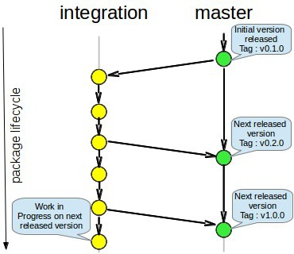
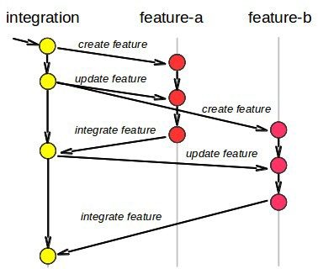
Tutorial: Useful tips and advices
●
A simple and efficient branching model (see doc-git wiki)
Integration: protected and “Developers can push”
Master: protected and NOT “Developers can push”
Permanent branches (protected)
Temporary branches for features development

Slide 122
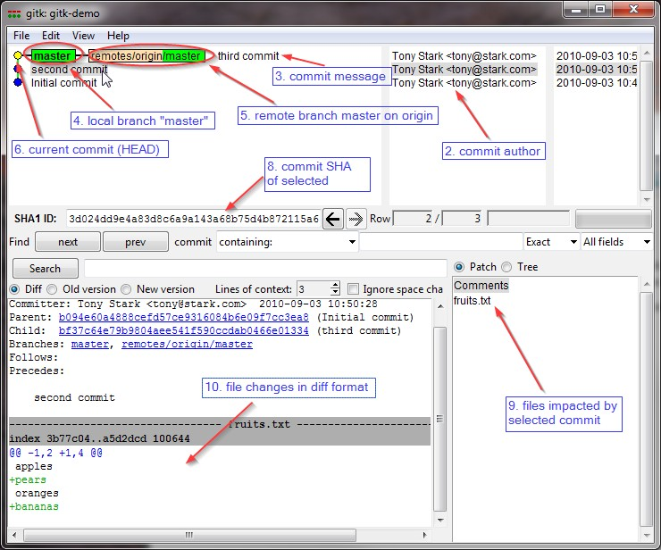
Tutorial: Useful tips and advices
●
Use gitk tool to understand the state of local repository

Slide 123
Conclusion
All basic concepts and commands of git have been studied … but they have hundreds of subtle refinements !!
Look at the wiki of project doc-git on gite.lirmm.fr (your contributions are welcome).
●
●
Basic functionalities of Gitlab have been studied … but there is still a lot to learn
Continuous integration will be part of a new tutorial in the future.

